Slide 1
Superforecasting for Business-Technical Professionals
Enhancing predictive skills to improve strategic decision-making
Notes:
---

Slide 2
Understanding Superforecasting
Notes:
Introduction to Superforecasting

Slide 3

Introduction to Superforecasting
Concept of Superforecasting
  Superforecasting means making highly accurate predictions using rigorous analysis and cognitive strategies.
Probabilistic Reasoning
  Superforecasting emphasizes probabilistic reasoning over intuition or limited data reliance.
Business Relevance
  It enhances decision-making, strategic planning, and risk management in business and technology.
Strategic Edge
  Adopting superforecasting helps anticipate market trends and technological disruptions effectively.
Notes:
Superforecasting is a concept introduced by Philip Tetlock and Dan Gardner in their book 'Superforecasting: The Art and Science of Prediction'. It refers to the practice of making highly accurate predictions about future events by employing rigorous analytical techniques and cognitive strategies. Unlike traditional forecasting, which often relies on intuition or limited data, superforecasting emphasizes probabilistic reasoning, continuous learning, and evidence-based analysis. For business-technical professionals, understanding superforecasting is crucial because it enhances decision-making, strategic planning, and risk management. By adopting superforecasting principles, organizations can better anticipate market trends, technological disruptions, and competitive dynamics, thereby gaining a strategic edge. This presentation explores the foundational ideas of superforecasting, its relevance to business and technology, and how professionals can integrate these insights into their workflows.

Slide 4
Key Characteristics of Superforecasters
Notes:
Traits of Superforecasters

Slide 5

Traits of Superforecasters
Open-Mindedness
  Superforecasters consider multiple perspectives and revise beliefs with new evidence.
Probabilistic Thinking
  They assign likelihoods to outcomes instead of using binary predictions.
Continuous Learning
  Superforecasters seek feedback, learn from mistakes, and refine their models continuously.
Collaborative Approach
  Sharing insights and challenging assumptions in diverse teams improves forecasts.
Notes:
Superforecasters exhibit a unique set of cognitive and behavioral traits that distinguish them from average predictors. These traits include open-mindedness, which allows them to consider multiple perspectives and revise their beliefs when presented with new evidence. They practice probabilistic thinking, assigning likelihoods to outcomes rather than relying on binary predictions. Continuous learning is another hallmark; superforecasters actively seek feedback, learn from mistakes, and refine their models over time. Collaboration also plays a vital role, as sharing insights and challenging assumptions within diverse teams leads to more robust forecasts. In business and technical environments, these traits translate into better strategic decisions, improved project planning, and enhanced adaptability. By fostering these qualities, organizations can cultivate a culture of informed foresight and resilience.

Slide 6
Methodologies and Tools
Notes:
Tools and Techniques

Slide 7
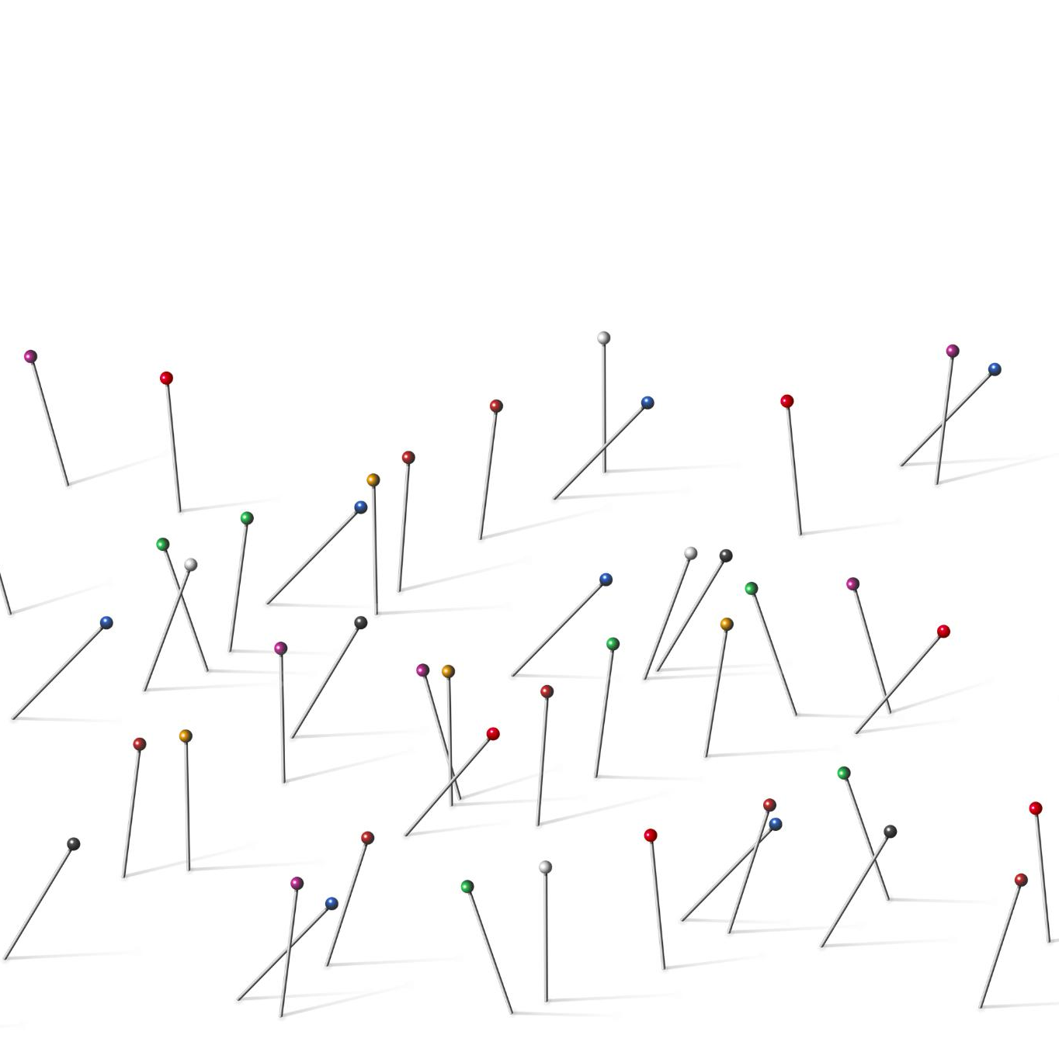
Tools and Techniques
Bayesian Reasoning
  Bayesian reasoning updates beliefs using new evidence and prior probabilities for accuracy.
Problem Decomposition
  Breaking complex problems into smaller parts allows detailed and manageable analysis.
Belief Updating
  Continuous adjustment of views as new data arrives improves forecasting accuracy.
Application in Business
  These tools enhance decision-making in uncertain business and technical environments.
Notes:
Superforecasters utilize a range of analytical tools and techniques to enhance the accuracy of their predictions. One foundational method is Bayesian reasoning, which involves updating beliefs based on new evidence and prior probabilities. This approach helps forecasters remain flexible and responsive to changing information. Decomposition is another key technique, where complex problems are broken down into smaller, manageable components, allowing for more precise analysis. Belief updating is a continuous process where forecasters adjust their views incrementally as new data becomes available. These methods are particularly valuable in business and technical contexts, where uncertainty is high and decisions have significant consequences. By integrating these tools into forecasting practices, professionals can improve their predictive capabilities and make more informed strategic choices.

Slide 8
Applications in Business and Technology
Notes:
Practical Applications

Slide 9

Practical Applications
Enhanced Strategic Planning
  Superforecasting improves predictions on market shifts and customer behavior for better strategies.
Proactive Risk Management
  Improved foresight helps identify disruptions early and enables timely mitigation strategies.
Reliable Technology Forecasting
  Probabilistic analysis enhances predictions about technology trends and innovations.
Real-World Business Impact
  Companies use superforecasting to guide investments, product development, and policy decisions.
Notes:
Superforecasting principles have wide-ranging applications in business and technology. In strategic planning, they enable organizations to anticipate market shifts, customer behavior, and competitive actions with greater accuracy. Risk management benefits from improved foresight into potential disruptions, allowing for proactive mitigation strategies. Technology forecasting becomes more reliable when grounded in probabilistic analysis and evidence-based reasoning. Real-world examples include companies using superforecasting to guide investment decisions, product development, and policy formulation. These applications demonstrate how adopting a superforecasting mindset can lead to better outcomes, increased agility, and sustained competitive advantage. Business-technical professionals can leverage these insights to enhance their decision-making processes and drive innovation.

Slide 10
Organizational Integration
Notes:
Building a Forecasting Culture

Slide 11

Building a Forecasting Culture
Encouraging Curiosity
  Organizations foster curiosity and critical thinking to challenge assumptions and improve forecasts.
Training for Skills
  Training programs develop skills in probabilistic reasoning, data analysis, and scenario planning.
Metrics and Accountability
  Using metrics to track forecasting accuracy promotes accountability and continuous improvement.
Leadership Role
  Leaders model forecasting behaviors and integrate them into organizational decision-making.
Notes:
Creating a culture that embraces superforecasting requires intentional effort and strategic initiatives. Organizations must encourage curiosity and critical thinking among employees, fostering an environment where questioning assumptions is valued. Training programs can equip staff with the necessary skills in probabilistic reasoning, data analysis, and scenario planning. Implementing metrics to evaluate forecasting accuracy and improvement over time helps reinforce accountability and continuous learning. Leadership plays a crucial role in modeling these behaviors and integrating forecasting into decision-making processes. By embedding superforecasting principles into the organizational fabric, companies can enhance their strategic agility, improve risk management, and make more informed decisions in complex environments.

Slide 12
Conclusion and Takeaways
Notes:
Summary & Key Takeaways

Slide 13

Summary & Key Takeaways
Transformative Forecasting
  Superforecasting transforms prediction and decision-making in business-technical fields.
Essential Mindset Traits
  Open-mindedness, collaboration, and continuous learning improve forecasting quality.
Analytical Tools Usage
  Bayesian reasoning and decomposition are key analytical tools for effective forecasts.
Cultural Integration
  Embedding forecasting practices into culture increases resilience and strategic foresight.
Notes:
Superforecasting offers a transformative approach to prediction and decision-making for business-technical professionals. By adopting a mindset that values evidence, probabilistic thinking, and continuous learning, individuals and organizations can significantly enhance the quality of their forecasts. Key takeaways include the importance of cultivating traits such as open-mindedness and collaboration, leveraging analytical tools like Bayesian reasoning and decomposition, and integrating forecasting practices into organizational culture. These principles not only improve decision accuracy but also foster resilience and strategic foresight. Embracing superforecasting can lead to better outcomes, more agile responses to change, and a sustained competitive edge in dynamic markets.

